Slide 1

DATA & ANALYTICS
RECRUITMENT
Name

Slide 2
WHAT’S ON THE AGENDA TODAY?
Who are we?
Our Markets
Awards
Questions

Slide 3

HARNHAM
WHO ARE WE?

Slide 4
HARNHAM
WHO ARE WE?
Harnham has the largest team of consultants purely recruiting for Data & Analytics in the world, enabling us to offer clients unrivalled access to a global network of candidates.
Established in 2006
Helping businesses large and small hire Data & Analytics talent in both perm and contract vacancies
Global Presence with offices in the USA, UK and Europe

Slide 5

HARNHAM
OUR MARKETS

Slide 6






RISK ANALYTICS
DATA &
TECHNOLOGY
DATA SCIENCE
MARKETING & INSIGHT
DIGITAL ANALYTICS
LIFE SCIENCE
ANALYTICS
92%
Of our clients agreed/strongly agreed that Harman truly are a specialist in Data & Analytics recruitment. (MESO Marketing)

Slide 7

HARNHAM
AWARD WINNING

Slide 8

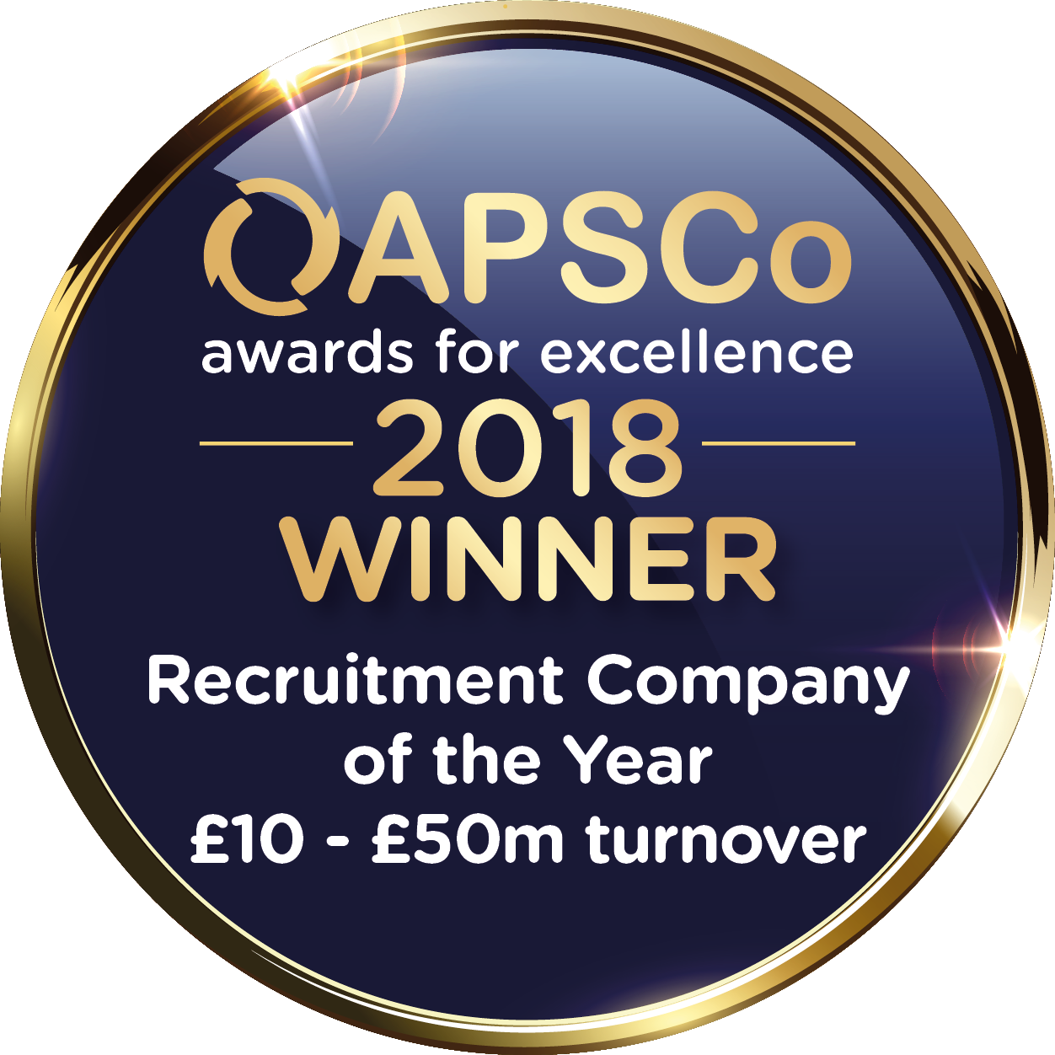
HARNHAM
AWARD WINNING
Harnham is a Top 25 Most Socially Engaged Staffing Agency
This enables Harnham to strategically target passive candidates that are already engaged with our brand and deliver unique candidates to our clients.
Apsco Awards for Excellence - Medium Sized Recruitment Company of the Year
Harnham are incredibly proud to have won this prestigious accolade and reflects the company’s tireless drive to achieve excellence within service, delivery, training and development.

Slide 9
TYPICAL
VACANCIES
Staff Data Scientist - Fraud (San Diego) $130,000 - $160,000
Data Scientist - Deep Learning (Los Angeles) $130,000 - $150,000
Senior Data Scientist - NLP (San Diego) $140,000 - $160,000
Senior Machine Learning Engineer (Los Angeles) $140,000 - $160,000
Senior Data Scientist – Series C (San Francisco) $160,000 - $180,000
Deep Learning Scientist – Healthcare (San Francisco) $190,000 - $200,000
Lead Data Scientist – Social Media (Santa Clara) $170,000 - $185,000
Product Science Manager – NLP (San Francisco) $180,000 - $210,000

Slide 10

QUESTIONS?

Slide 11
THANK YOU
FOR YOUR TIME
Name

